Slide 1


Citi Bike Data Analysis
By [Omar Atta]

Slide 2
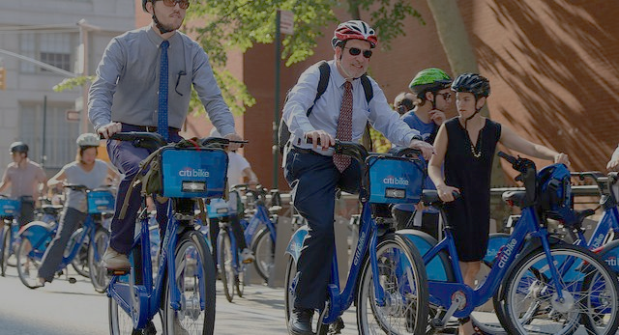
Project Goal:
To better understand the behavior of Citi Bike’s customer base (both one-time users and subscribers) and how they use Citi Bikes
Also, Discover the best times and places that have more loads than others
This will help us to:
Identify where and when more bikes should be installed
Create targeted marketing campaigns that will appeal to different customer segments
Make more profits and could even expand quickly in a well-studied path

Slide 3
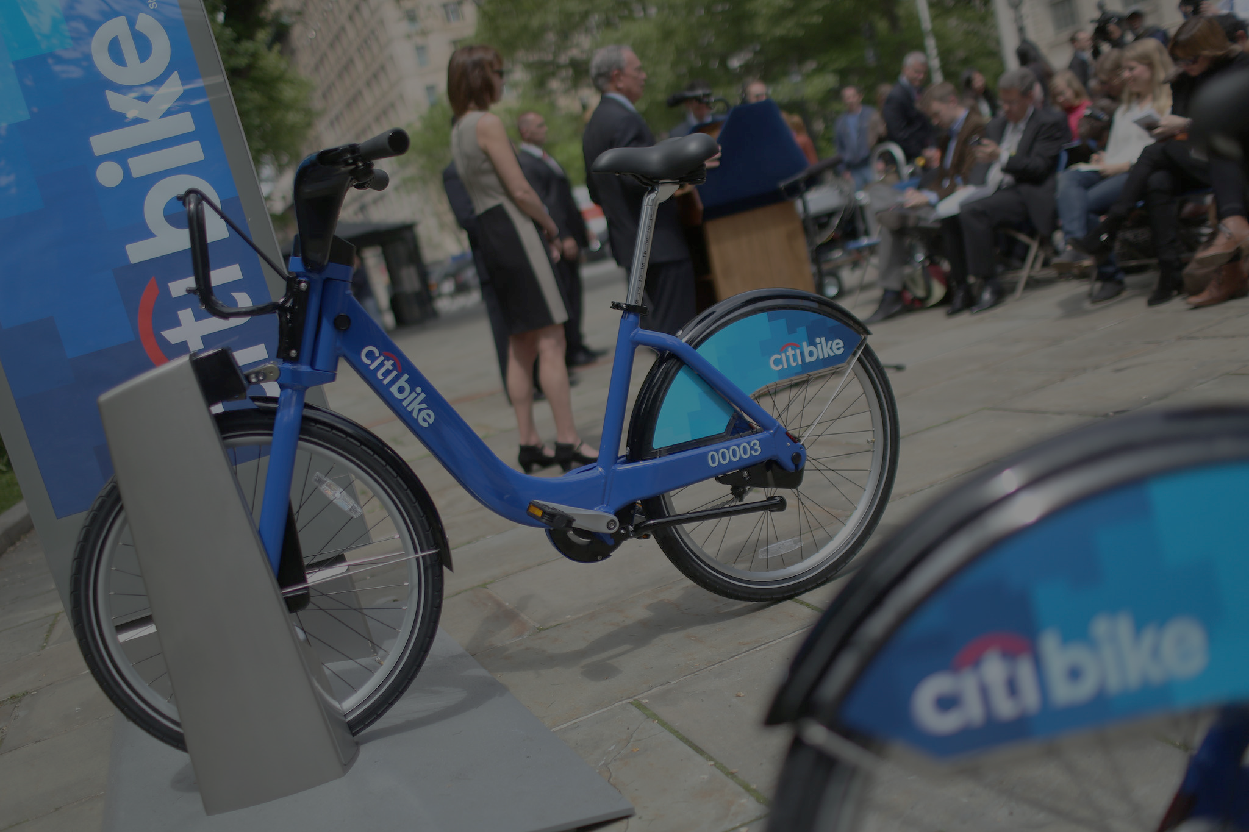
Key questions:
What are the most popular pick-up locations across the city for Citi Bike rental?
How does the average trip duration vary across different age groups, and over time?
Which age group rents the most bikes?
How does bike rental vary across the two user groups (one-time users vs long-term subscribers) on different days of the week?
Do factors like weather and user age impact the average bike trip duration?

Slide 4

Findings & Insights

Slide 5
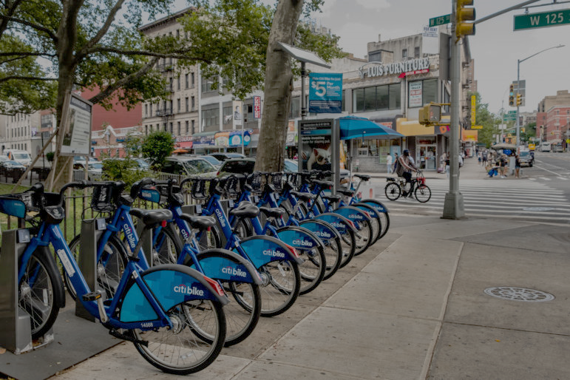
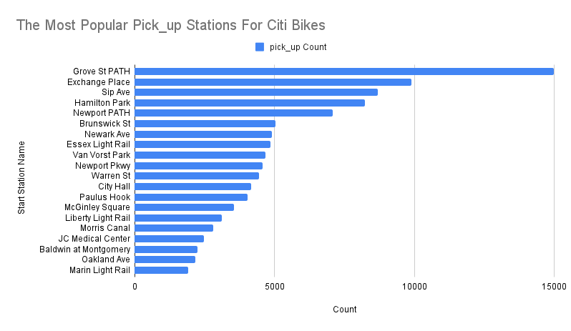
What are the 20 most popular Citi Bike pick-up locations?
Here, you can see that, the “Grove St PATH” is the most usable pick_up station for Citi_Bikes users.

Slide 6

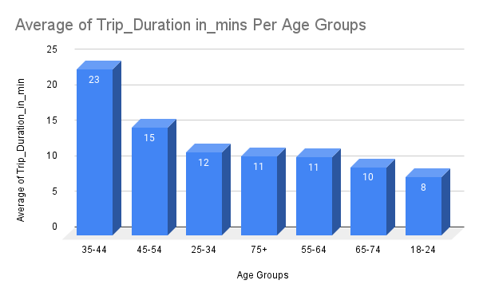
2. How does the average trip duration vary across different age groups, and over time?
From this bar chart, you can notice that, the highest Average Trip_Duration (23 mins)related to (35-44) Age Group.
And the Lowest Average Trip_Duration(8 mins) related to (18-24) Age Group.

Slide 7
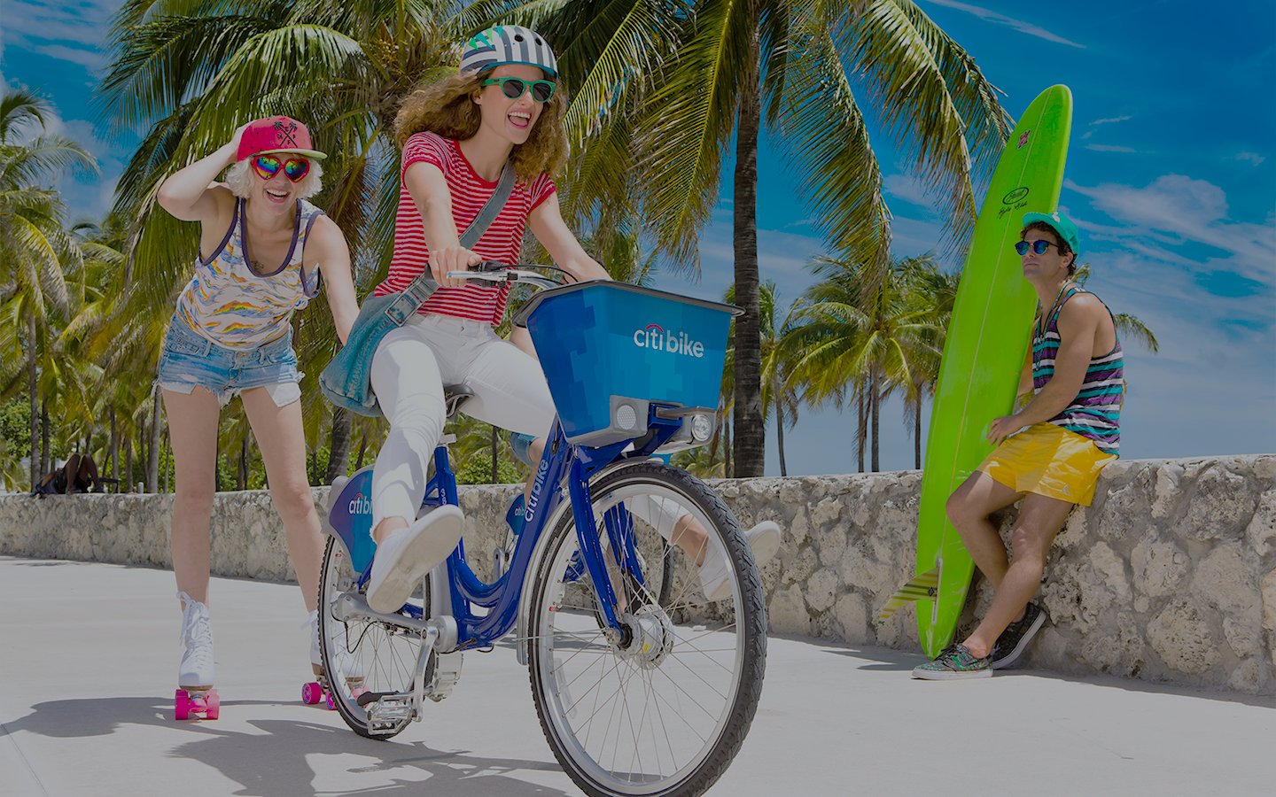
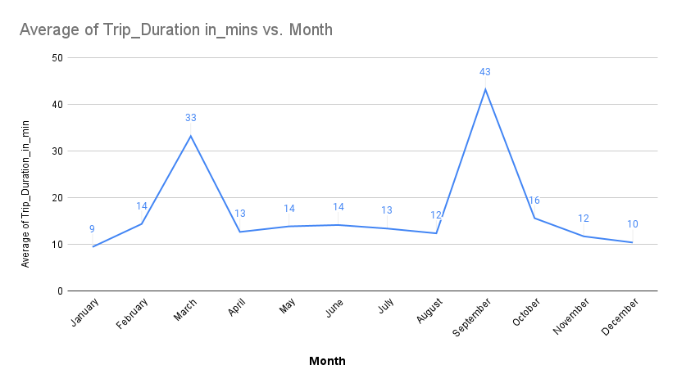
2. How does the average trip duration vary across different age groups, and over time?
From this line chart, we can notice that ,
The highest 2 months in the Average Trip Duration are September and March
ON the other hand,
The Lowest 2 months in the Average Trip Duration are January and December

Slide 8
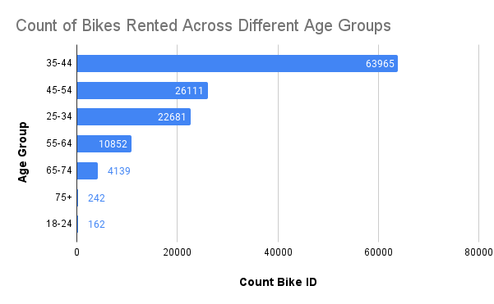
3. Which age group rents the most bikes?
For the second time, (35-44)
Age Group Comes as the First age group in renting bikes numbers with a big gap with the second age group in raw.
Also, the (18-24) comes as the last age group in renting bikes numbers with a very small number comparing to the first age group

Slide 9
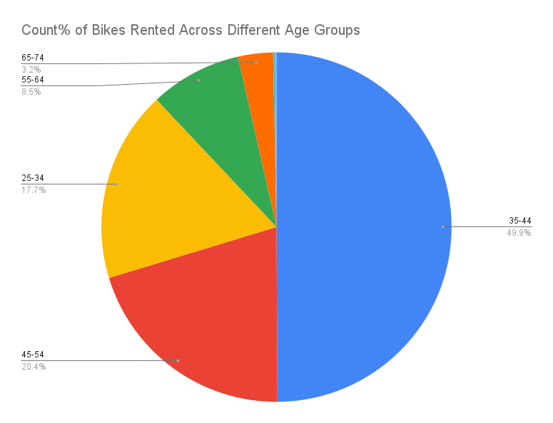
3. Which age group rents the most bikes(Percentages)?
(35-44) age group Comes First with a big gap with other age groups in raw.
(It Shapes Almost Half of The Total Renting Percentages)
Also, the (18-24) comes as the last age group in bikes renting percentages with a percent that you can’t even notice.

Slide 10
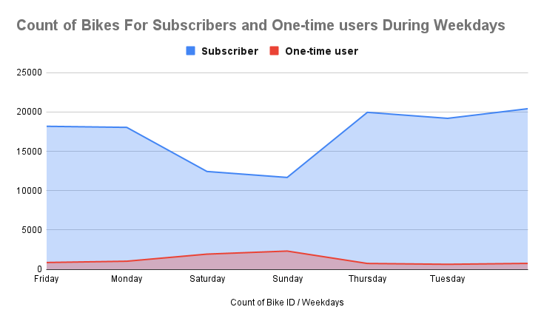
4. How does bike rental vary across the two user groups (one-time users vs long-term subscribers) on different days of the week?
Most of users are Subscribers
only a very few users are one-time users
It shows that on Saturday and Sunday “one-time users” percentages are higher than usual and on the opposite for the subscribers

Slide 11
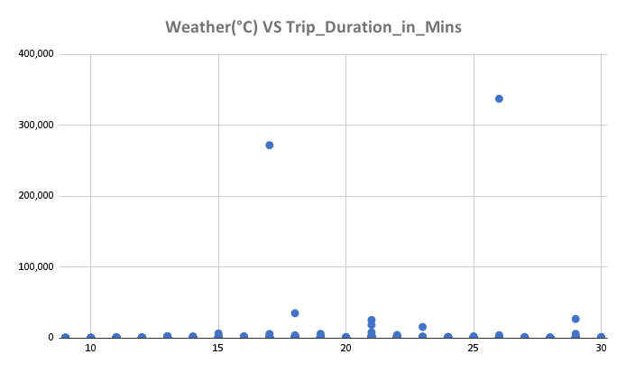
5. Do factors like weather and age impact the average bike trip duration?
The weather impact on Average_Trip_Duration.
As it appears that the average trip duration is mostly high in degrees from 20c to 25c
Also some outliers can be noticed but not helpful as it’s very few

Slide 12
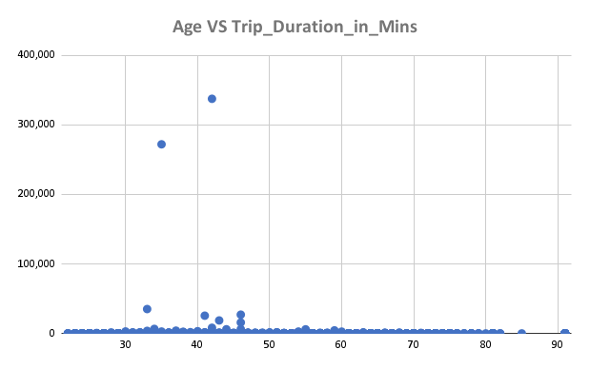
5. Do factors like weather and age impact the average bike trip duration?
The weather impact on Average_Trip_Duration.
As it appears that the average trip duration is mostly high in Ages from 40 to 50
Also some outliers can be noticed but not effective as they’re very few

Slide 13
Summary

Slide 14
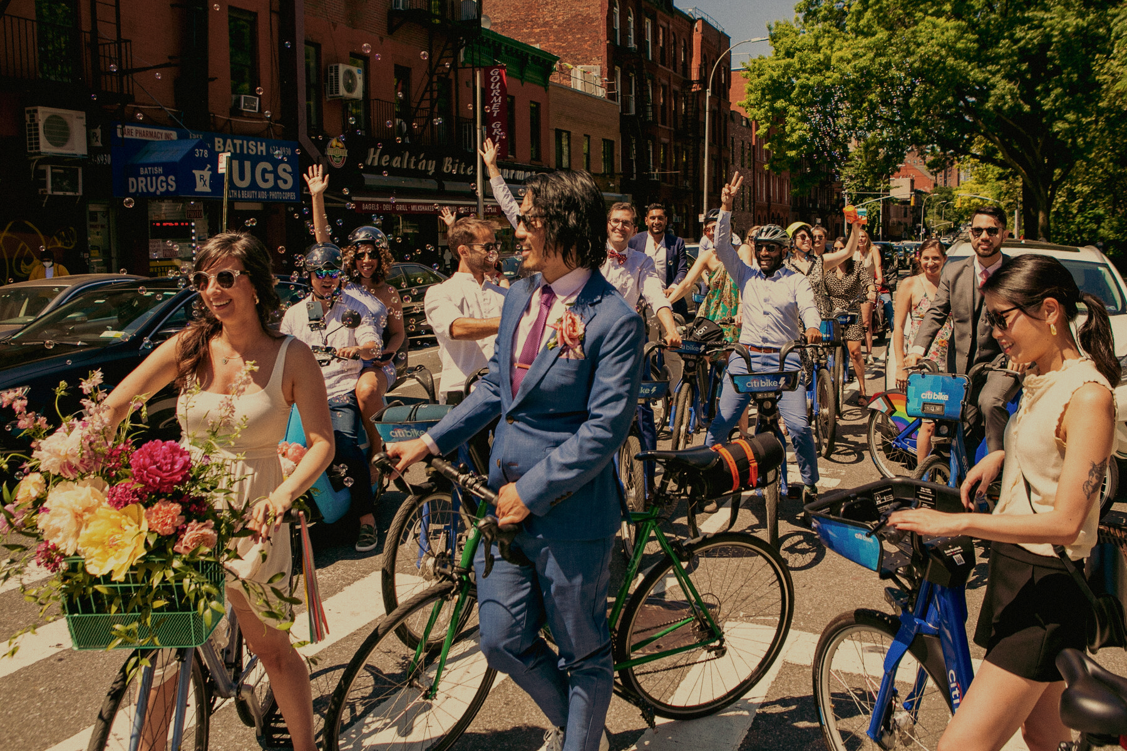
Summary of findings:
Top 5 pick-up locations for bikes:
Grove St Path, Sip Ave, Newport Path, Newark Ave, Van Vorst Park
Customer base: - Most users here are subscribers and one-time-users are very few.
- (35-44) age group are the most dominant group in many aspects and (18-24) age group is the on the opposite side .
Citi Bike customer behavior:
subscribers are active almost all the week, on the other hand, one-time-users are very few during the whole week but they get more active during the weekend.
(35-44) age group has the highest average_trip_duration,also, has the highest_bikes_rental_rate among other age groups,while,(18-24) age group has the lowest average_trip_duration and the lowest_bikes_rental_rate
September and March (Hot And Warm times)Has the highest Average_Trip_Duration, But, January and December(Cold Times) Has the lowest Average_Trip_Duration .

Slide 15
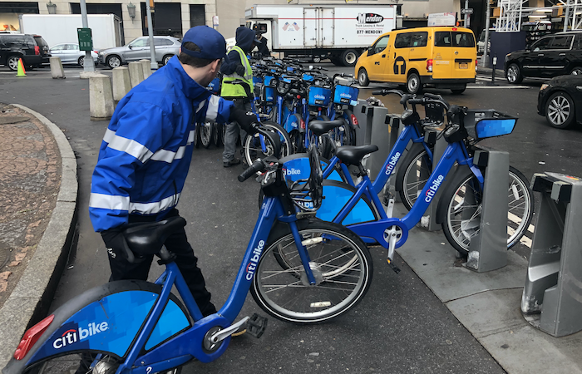
Actions & Recommendations

Slide 16
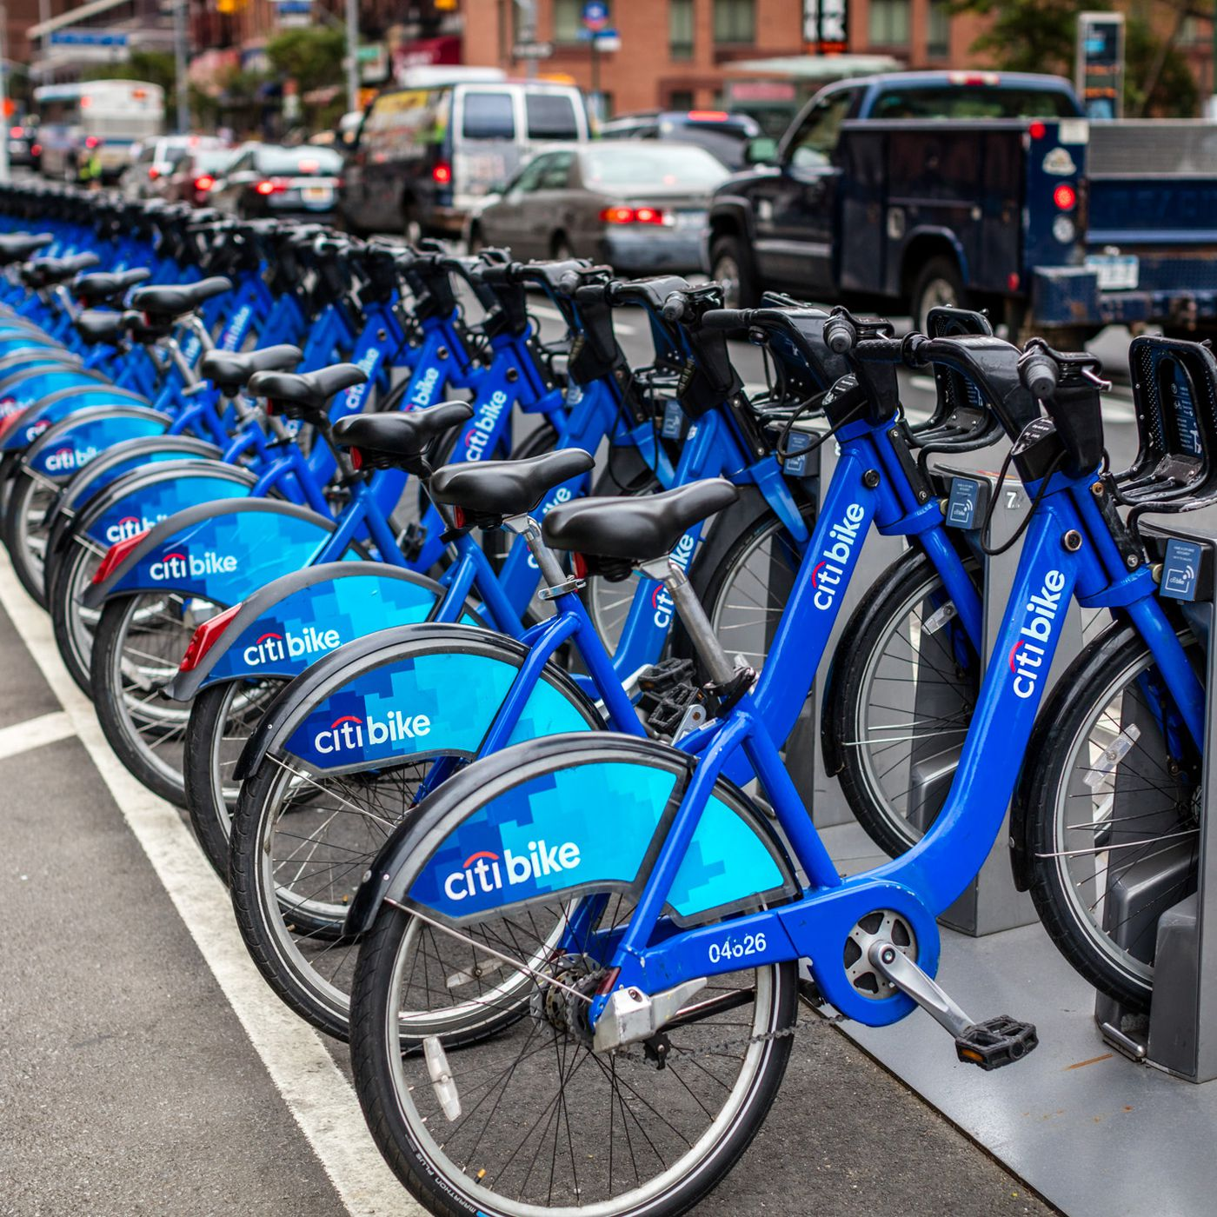
Recommended actions:
Product Recommendations:
Install more bikes at Top 5 pick-up locations
Make more bikes available in(September and March)as this is when Citi Bike users take the longest trips (which means bikes will be unavailable for longer)
Marketing recommendations:
The Citi Bike customer base is mostly a Subscriber who aged between(35-44), who are most active During The Weekdays. This tells us that they are probably people who live in New York and use Citi Bikes to commute. Marketing and advertising campaigns should therefore target this particular demographic.

Slide 17
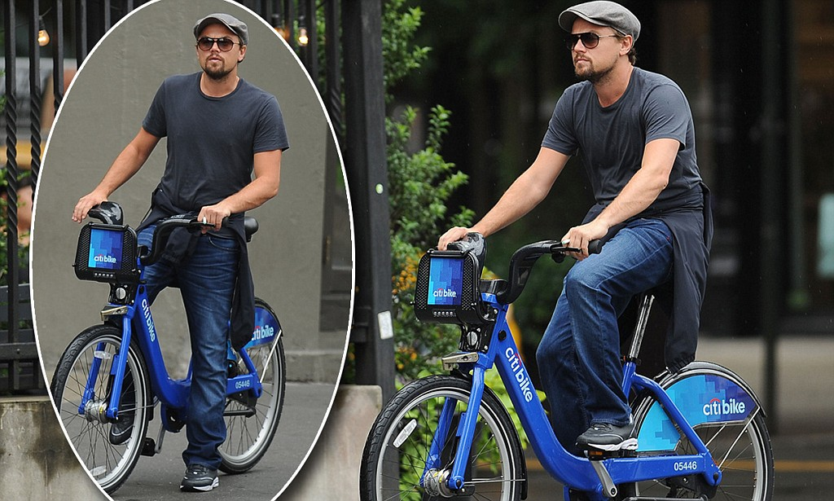
Thank you!

